Slide 1
Algorithmregister
A mathematical formula should never be "owned" by anybody! Mathematics belongs to God. Donald Knuth.
A. Batenburg, November 4, 2022

Slide 2
Documenthistory
Verrsionmanagement / changehistory
Version 0.0.1: first exploration, January 25, 2021
Version 0.0.2: addition variant case, January 27, 2021
Version 0.0.3: addition of extra roles, January 28, 2021
Version 0.0.4: put focus, July 5, 2021
Version 0.0.5: update distribution list, July 8, 2021
Version 0.0.6: addition of software architecture, July 15, 2021
Version 0.1.0: update technical session #01, December 13, 2021
Version 0.2.0: update standards and tekst, November 4, 2022
Distributiionlist
André Batenburg, information architecture
Anne Schoenmakers, policy officer Digital Transformation province of North Brabant
Bernard Vuijk, project manager projects Environmental law
Constantijn Hagenaar, business analyst
Eric Herman, Foundation for Public Code
Erik Verhaar, functional manager team Environment policy
Ivonne Jansen – Dings, strategic advisor technology and society
Jan Ainali, Foundation for Public Code
Johan Groenen, Tiltshift
Maarten Geraets, Tiltshift
Marten Terpstra, productowner projects team Environment policy

Slide 3
Reading guide
The diagrams in this document are based on the Archimate standard, which is a modeling language from The Open Group, see https://www.opengroup.org/ . Archimate is for creating an architecture model, see https://www.opengroup.org/archimate-forum/archimate-overview .Het model volgens de Archimate standaard is vastgelegd met behulp van het open source tool Archi, zie https://www.archimatetool.com/
Each paragraph begins with a metamodel of the Archimate model elements used in that paragraph. The paragraphs are:
Motivation and goals, see sheet #04 for the metamodel
Business architecture, see sheet #12 for the metamodel
Information architecture, see sheet #18 for the metamodel Een uitzondering is de paragraaf met de softwarearchitectuur. Die is uitgewerkt volgens het C4-model, zie https://www.infoq.com/articles/C4-architecture-model/ . Het metamodel van het C4-model hiervan is uitgewerkt in Archimate, zie sheet #21.
Het C4-model van de softwarearchitectuur is ook in Archimate zelf vastgelegd, door middels labels gebruik te maken van een viewpoint in Archi, zie https://www.archimatetool.com/blog/2020/04/18/c4-model-architecture-viewpoint-and-archi-4-7/ hoe dit werkt in Archi.
De kleurstellingen van de Archimate standaard zijn gevolgd. De enige uitzondering is het model met de rollen en actoren, zie sheet #12. De kleur oranje is daar gebruikt om de rollen die in scope zijn te duiden. De overige rollen (in de kleur geel volgens de standaard) zijn buiten scope.

Slide 4
Terms
Interestholder: Citizens and companies that could be adversely affected by the initiative of another person or by a decision of a competent authority. The interestholder assesses (proposed) decisions and can lodge an objection, submit an opinion or appeal to the competent authority.
Competent authority: Administrative bodies that take decisions. Government organizations can assign tasks to executive organizations for execution of tasks. A competent authority can also mandate an executive organization to take decisions in the execution of tasks.
Client: Responsibility for managing executive organizations.
Executive organization: Private or government organization that performs tasks as a contractor on behalf of a government organization.

Slide 5
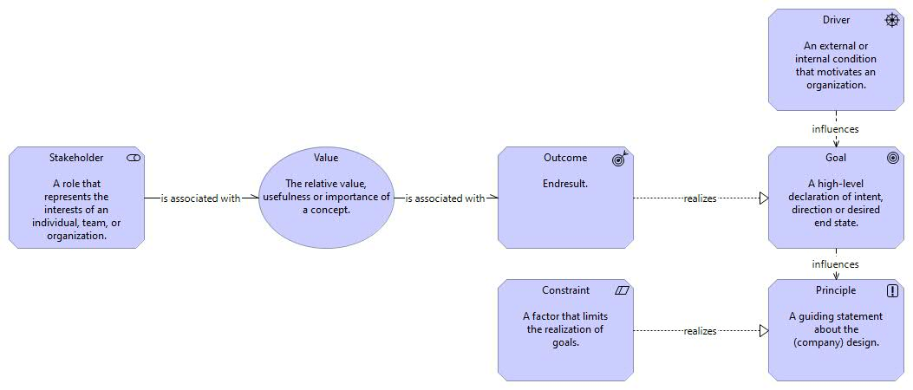
Motivation and goals
This section describes the stakeholders, values, results, drivers, policy goals, principles and constraints (legislation and standards).

Slide 6
Motivation
First, we looked at the user stories. We deduced from this that transparency of decision-making and openness of algorithms contribute to the driver that the government wants to be transparent. In addition, the government wants to be compliant and therefore comply with legislation and regulations. The AR contributes indirectly to the transparency of decision-making. Indirect because the AR does not provide insight at the level of an individual decision.
Subsequently, it was examined which guidelines should be provided. They are based on the principles:
The AR is open
The AR exchanges data in an open format
The AR is compliant.
The resulting guidelines are:
The API of the AR uses JSON (open)
The API of the AR is described (open)
The API of the AR is documented, this implies that there is an informationmodel (open)
An open standard has been developed for the AR (open exchange of data)
The AR meets the WCAG requirements to meet Digital Acessibility (compliance).

Slide 7
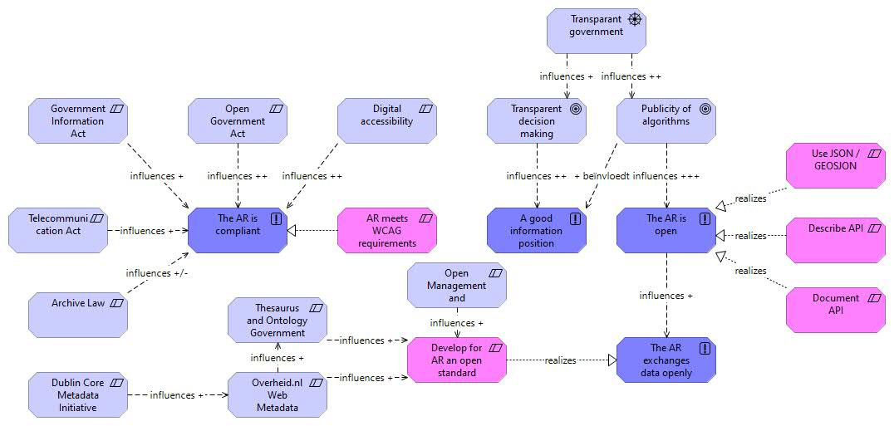
Motivation

Slide 8
Guidelines for the open standaard
The open standard for the AR:
Has been developed and managed in an open process according to the standard Management and Development Model for Open Standards (BOMOS).
Is managed by an organization that manages open standards for publication (proposal is KOOP, Knowledge and Exploitation Center for Official Government Publications).
Is suitable for publishing metadata on a portal with official government information from the Dutch government (overheid.nl).
Is based on the open standard Overheid.nl Web Metadata (OWMS).
Is based on the open standard Dublin Core Metadata Initiative (DCMI).
Takes into account the standard Thesaurus and Ontology Government Information (TOOI) that is under development.

Slide 9
Guidelines for the use of API’s
The APIs being developed for the AR comply with:
Description API: The description of the API conforms to the standard OpenAPI Specification for describing REST APIs.
Documentation API: The API setup and documentation complies with the standard REST API Design Rules for structuring and documenting REST APIs.
Security API: The security of the API complies with the standard NL GOV Assurance profile for OAuth 2.0 for securely authorizing access to REST APIs.

Slide 10
Guidelines for the developed applications
The applications that are being developed for the AR meet:
an externally used web application or mobile web app complies with the cookie policy as embedded in the Telecommunications Act.
an internal website, an external website or a mobile web app must meet the subset of Digiaccessible's requirements with classification A or classification AA.
an internally used web application must, in principle, comply with the subset of the requirements of Digi Accessible with classification A or classification AA.
a mobile app must comply with the entire set of ICT security guidelines for mobile apps.
An application that uses a browser (HTML) supports the most commonly used browsers: Chrome, Firefox, Safari, Edge.

Slide 11
Goals
However, the idea is that the above does not exactly indicate the principles to be used. That is why we looked additionally at what the stakeholders want. The stakeholders are limited to the interestholder (citizen), representative (local Council), algorithm holder (responsible), process owner and the executor (enforcer). Looking at their user stories, this gives a number of values: Trust, Controllability, Minimum disclosure requirement, Explainability. Outcome is then defined that support the purpose of Publicity algorithms. This yields the following four principles
A good information position: Information is available, usable and resistant. Information is presented in an understandable way to the customer (both inside and outside the organization), so that he/she is in control of the use of his/her data. Customers must be able to identify incorrect registration of their data. Note: this is about the transparency of the algorithm!
The fundamental of the algorithm is known: a decision must have been made about the use of the algorithm and this is described in the AR.
AR standard names minimal set: the standard describes which data is always in the description of an algorithm. This ensures that the algorithms are accessible at a comparable informationlevel.
AR standard includes operation and data: in order to understand an algorithm, it is a requirement to describe in the AR the operation of the algorithm and the data used in the algorithm.

Slide 12
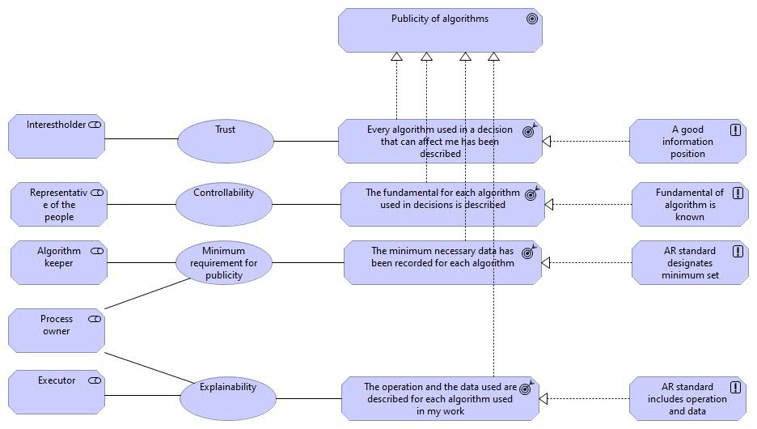
Goals

Slide 13
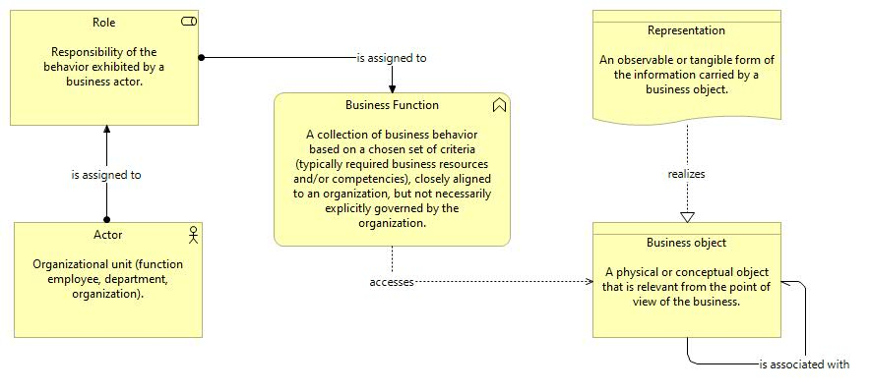
Business architecture
This section describes the business objects, representations, business functions, roles and actors.

Slide 14
Businessobjectmodel
The main point is that the application of an algorithm must be based on a foundation (a law, a regulation), is used in a process and that the algorithm makes use of data. That is the scope of information you need about the application of an algorithm.
In the process, the outcome of the algorithm is input to arrive at a decision.
You can appeal the decision and you can then lodge an objection or appeal. That objection or appeal can implicitly concern the algorithm. But you don't explicitly object to the algorithm itself. You can, however, lodge an objection or appeal against the decision to use the algorithm. However, there is no statutory provision for such a decision.

Slide 15
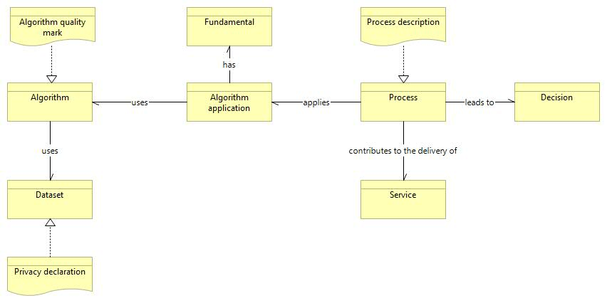
Businessobjectmodel

Slide 16
Roles and actors
From the user stories, the following roles are important from the use of the algorithm register, which are marked in orange in the figure: interestholder (focus on citizen), representative of the people, process owner, executor (focus on enforcer) and algorithm holder.
The following roles are important from the point of view of the content of the algorithm register: software developer, algorithm supervisor and auditor, data source holder, process owner and service owner. For example, because they provide information about the algorithm.
The administrator is important because he decides about the fundamental on which the algorithm is used.

Slide 17
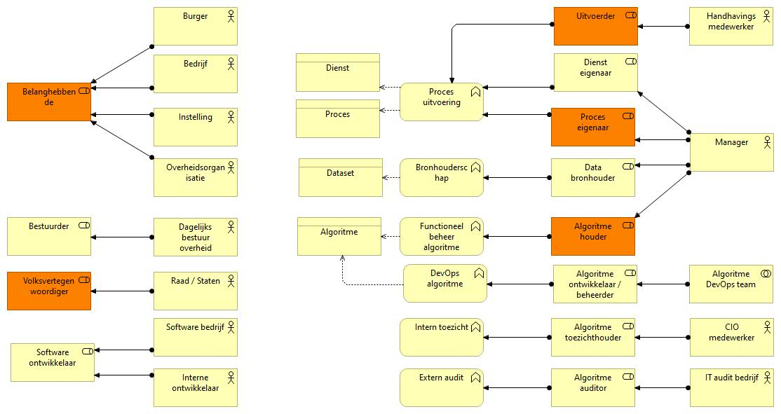
Roles and actors
The roles in scope are colored orange.
A distinction is made between the role responsible for applying the algorithm in the process and the role responsible for developing the algorithm. The process manager is also the holder of the algorithm. This means that the roles of process owner and algorithm holder are in scope.
The registration does not describe the (technical) operation of the algorithm itself, so the role of the algorithm developer/administrator is out of scope.

Slide 18
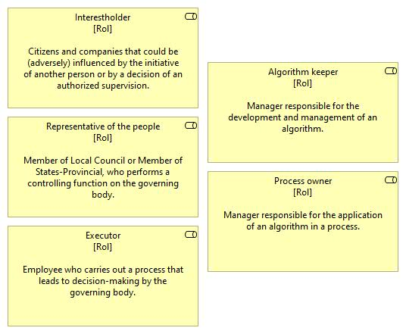
Roles in scope

Slide 19
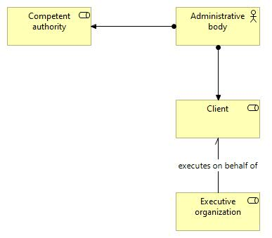
Roles in decision-making and execution
In the role of competent authority, an administrative body takes decisions for the tasks assigned to it. The execution of the tasks may be assigned to an executive organization. An algorithm is applied in the execution of the tasks.
In that situation, the administrative body should instruct the executive organization to register the application of the algorithm.
It may be the case that the administrative body grants the executive organization the mandate to take certain decisions itself on behalf of the competent authority.

Slide 20
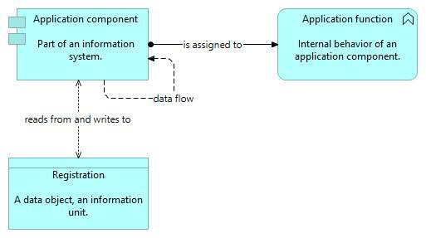
Information architecture
This section describes the registrations, application functions and application components.

Slide 21
Registrations and applications
Here a fundamental choice has been made to exclude catalogs about applications and services. Information about the process is recorded in the algorithm register. After all, this is necessary to make transparent what role the algorithm plays in the process. The data catalog is relevant because you want to get information about the data used in the decision making. A government body that does not have a data catalog must be able to record the information in the algorithm catalog.
A second fundamental choice is not to involve information about specific decisions. That would require information that is included in process systems. However, those process systems are organization-specific. The scope of the algorithm register is the metadata about the algorithm, not the data used by an algorithm in a specific decision making!
An interested party can request this information by submitting an objection or lodging an appeal. An existing process can be used for this. Objection/appeal must be about the (intended) decision (substantive or about the role of the algorithm), not about the algorithm itself.
Choice is to offer the possibility to publish the information about algorithms on the corporate website of the government body and also to offer the possibility to publish this information from all government bodies in a nationwide environment. The latter may in the future be content published on government.nl via PLOOI or on an international site as part of www.data.europa.eu.

Slide 22
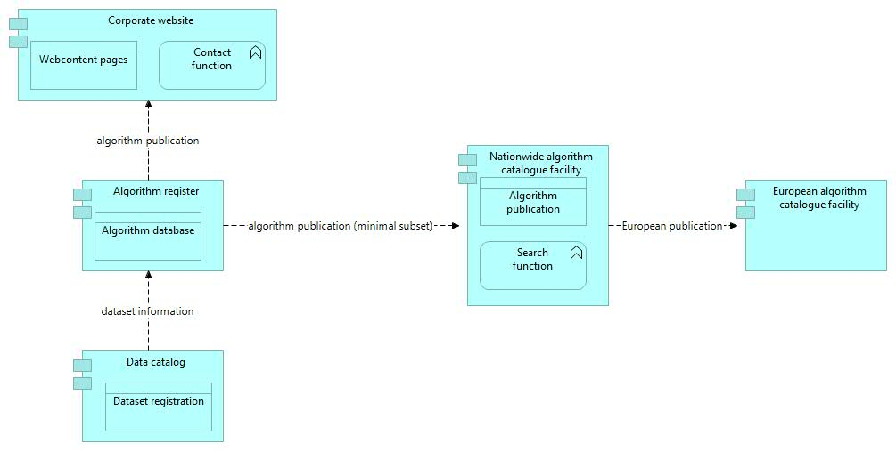
Registrations and applications

Slide 23
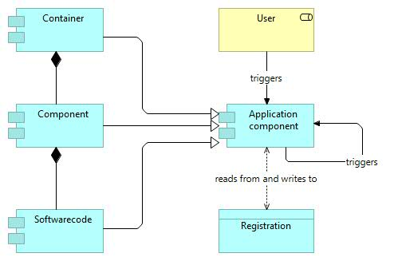
Software architecture
This section describes the software architecture based on the C4 model. This model consists of 4 levels of abstraction, of which the first three have been used:
System context diagrams: show the information system (algorithm catalog) in scope in relation to users and other information systems
Container diagrams: decomposition of the information system in containers. A container represents an application or a data store.
Component diagrams: decomposition of a container into components.
Code diagrams: design of the software code.

Slide 24
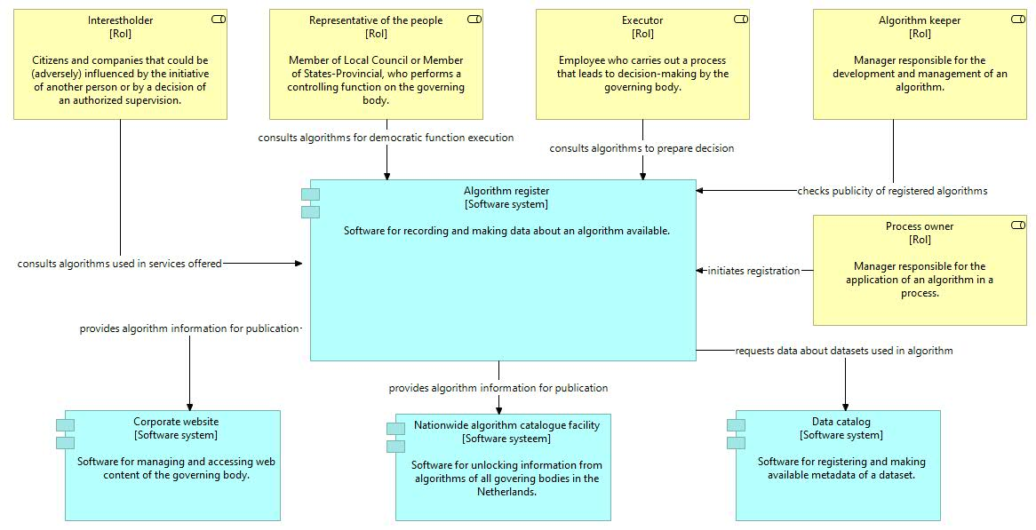
Contextdiagram Algorithm register

Slide 25
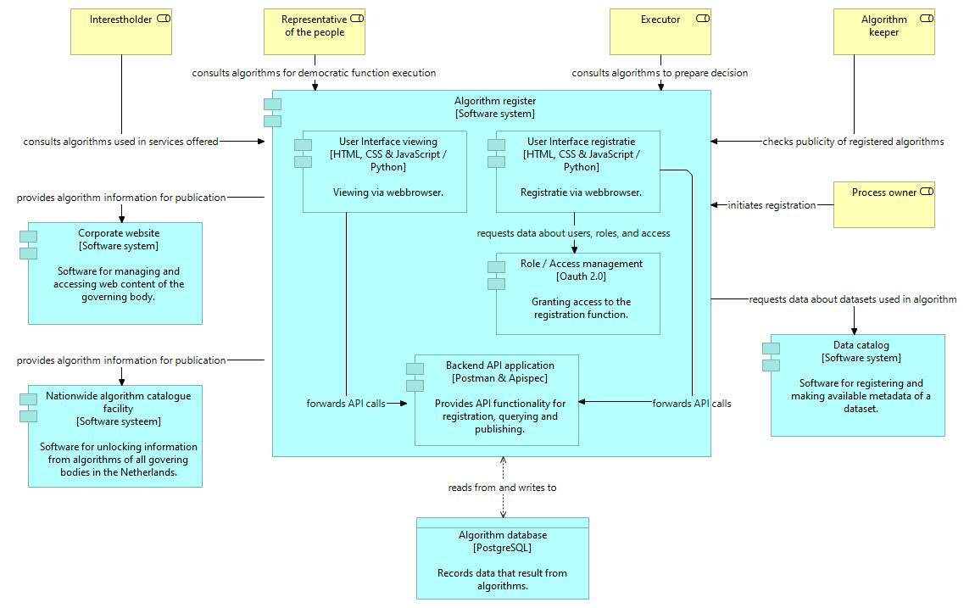
Containerdiagram Algorithm register

Slide 26
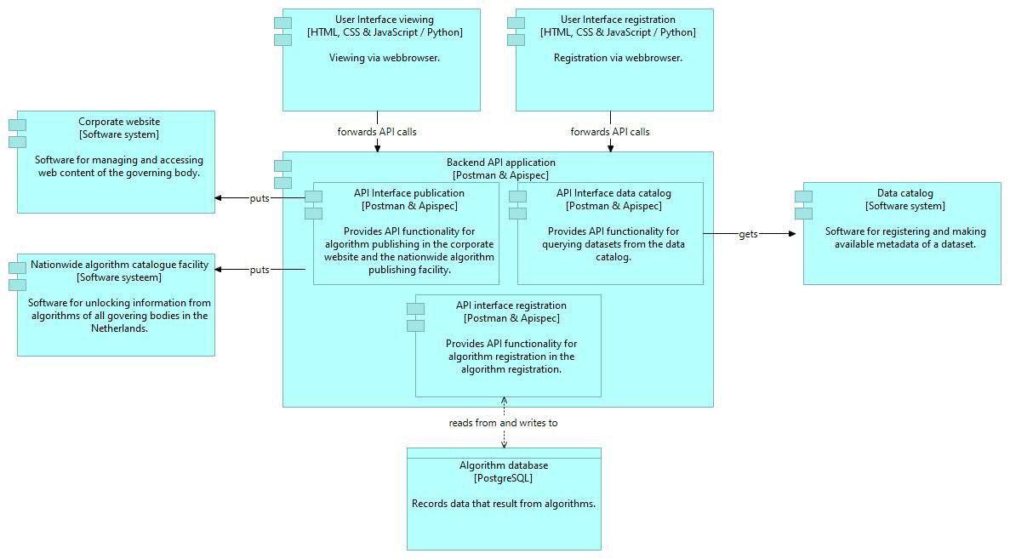
Componentdiagram Backend API application
The Backend API application has an API for the national facility with which the national facility can harvest the minimum set of metadata.

Slide 27
Softwarestack 1/3
The following software stack emerges from the software architecture :
Target | Function | Baseline Component | Target Component
Basic IT Infrastructure | Server operating system |  | Linux
Basic IT Infrastructure | SQL-databasemanagement system |  | PostgreSQL
Basic IT Infrastructure | Document-oriented database for creating a search engine, is more Java oriented |  | ElasticSearch
Basic IT Infrastructure | HTTP server for communication between JavaServerPages and webserver, is more Java oriented |  | Apache Tomcat version 8.5

Slide 28
Softwarestack 2/3
The following software stack emerges from the software architecture :
Target | Function | Baseline Component | Target Component
Application development | Programming languages for the frontend of a web application in the browser |  | HTML, CSS and JavaScript
Application development | Programming language, general, for the backend |  | Python 3.6.x
Application development | Library for object serialization and deserialization i.r.t. Python |  | Marshmallow 3.0.0b20
Application development | Microwebframework |  | Flask 1.0.2
Application development | Extension on Flask for generation / authentication with JSON Web Token (JWT) |  | Flask JWT extended 3.13.1
Application development | Extension on Flask for interacting with SQL databases |  | Records 0.5.2 & SqlAlchemy 1.3.0b1

Slide 29
Softwarestack 3/3
The following software stack emerges from the software architecture :
Target | Function | Baseline Component | Target Component
API development | Extension on Flask for developing RESTful APIs |  | Flask Restful 0.3.6
API development | API documentation generation |  | Apispec 1.0.0b5
API development | Extension on Apispec for integration with web frameworks |  | Apispec web framework integration
API development | Extension on Apispec for integration with Marshmallow |  | Apispec Marshmallow integration
API development | Development platform for APIs |  | Postman

